Slide 1




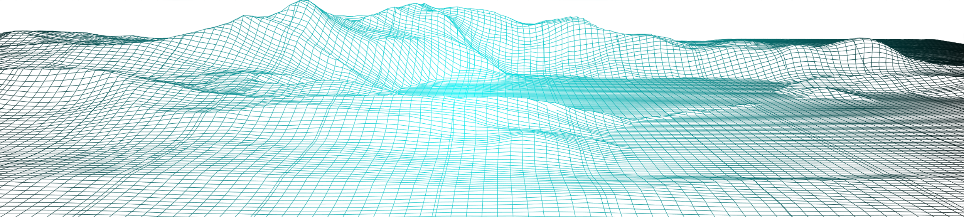
Digital Project Monitoring Application
“Jal Rekha”
August 2025

Slide 2
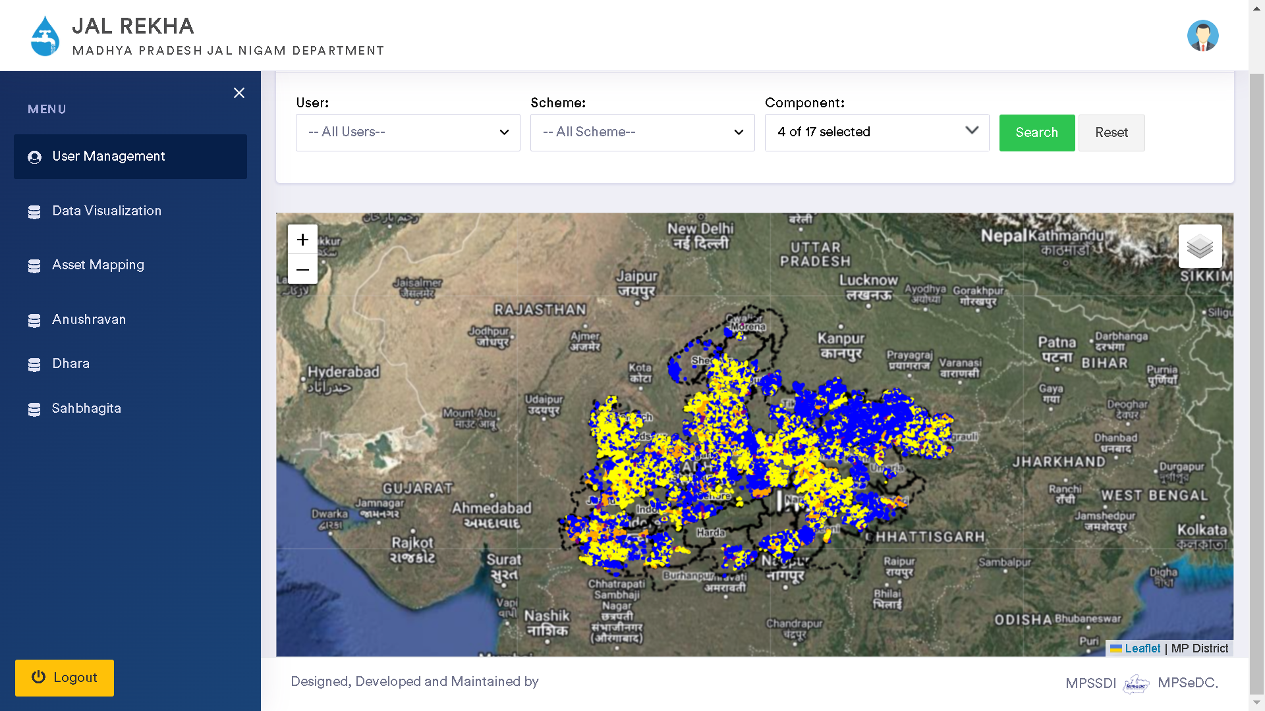
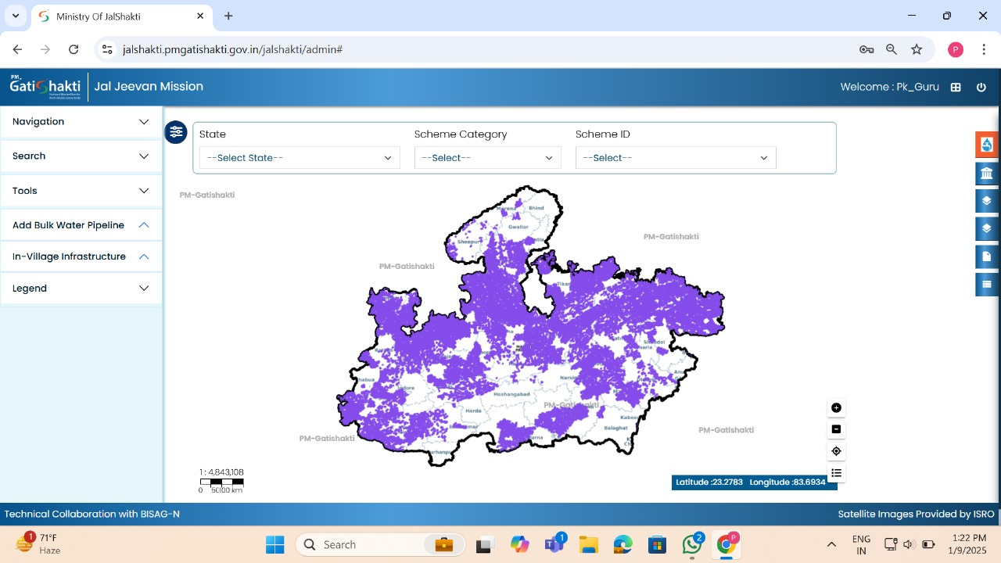
Digital Project Management - Jal Rekha
“Jal Rekha” is a GIS based tool which can be easily accessible via android & web application to monitor and management of the progress in MVS (Multi Village Water Supply Schemes) under JJM in Madhya Pradesh.
Information about the MVS assets (Intake Well, WTP & Supply lines) constructed over the ground are geo-tagged in Jal Rekha application and these were also successfully uploaded over the PM- Gati Shakti portal through an API.

Slide 3
Jal Rekha
Precise Asset Tracking : Real time location tracking of assets installed and parallel visual comparison with approved designs.
Ingenious Quality Assurance: Reduce time consumption in inspection procedures and improved work quality through categorized inspections.
Advance Decision Making : Weekly publishing of progress in workplan, inspection and water supply details enables the “Jal Rekha” team to take precise decisions in time.
Partnering Up : Partnering the geographically referenced design & drawing data sets with other departments like Telecom, MPEB, Domestic Gas Supply agencies etc enables them to receive NOC from respective departments and to execute their plan in time with out creating any fuss.

Slide 4
Digital Project Monitoring – Jal Rekha
1. Execution
Jal Rekha
Asset Mapping
2. O&M
Dhara
Anushravan
Jal Rekha
Nirmal
Sopan
Jal Samadhan
Sahbhagita
O&M Billing
FHTC

Slide 5
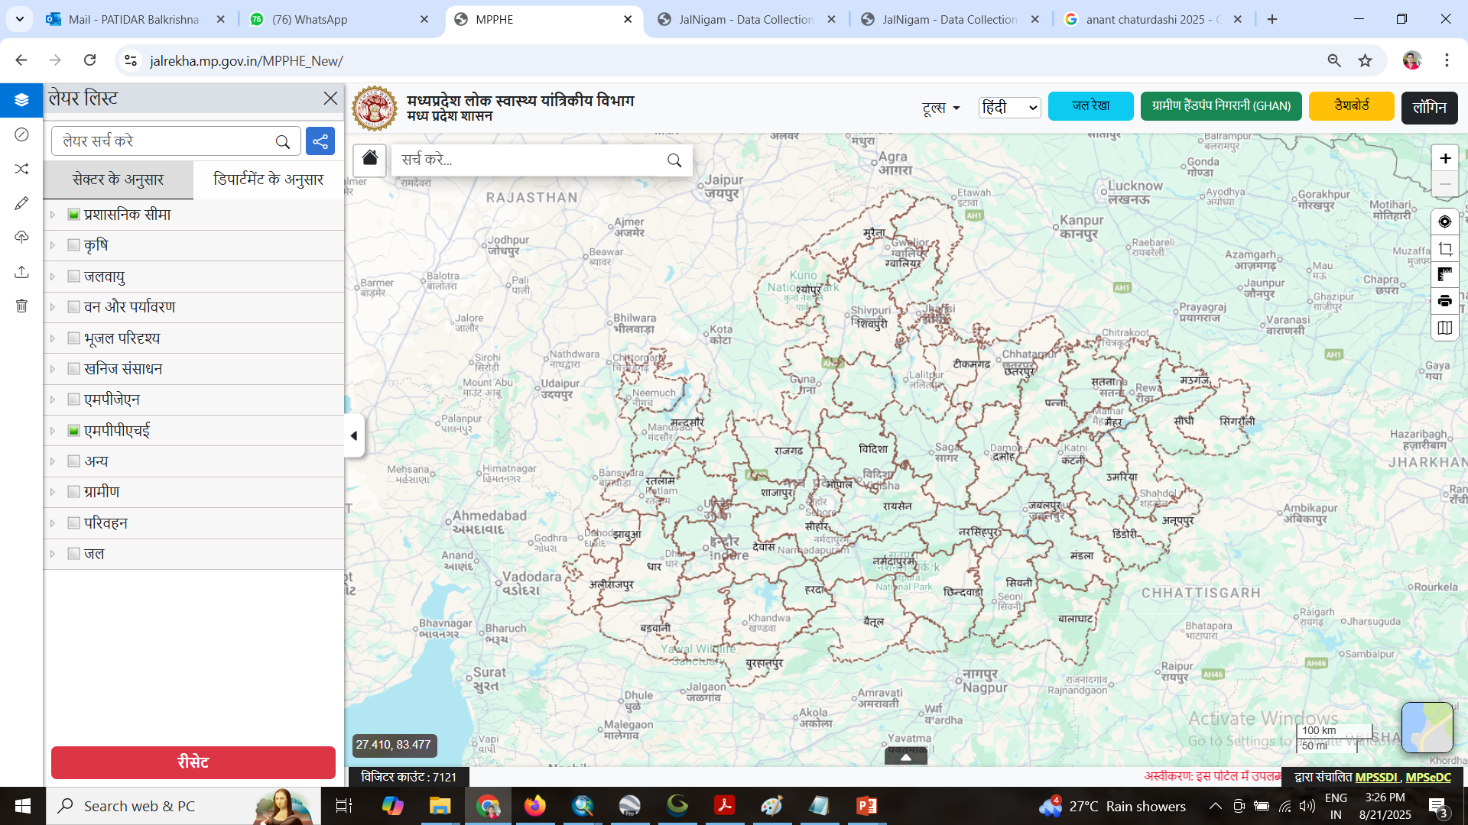
MPPHE Geo Portal

Slide 6
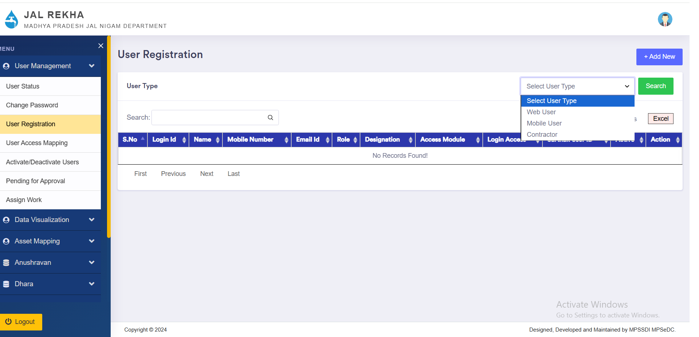
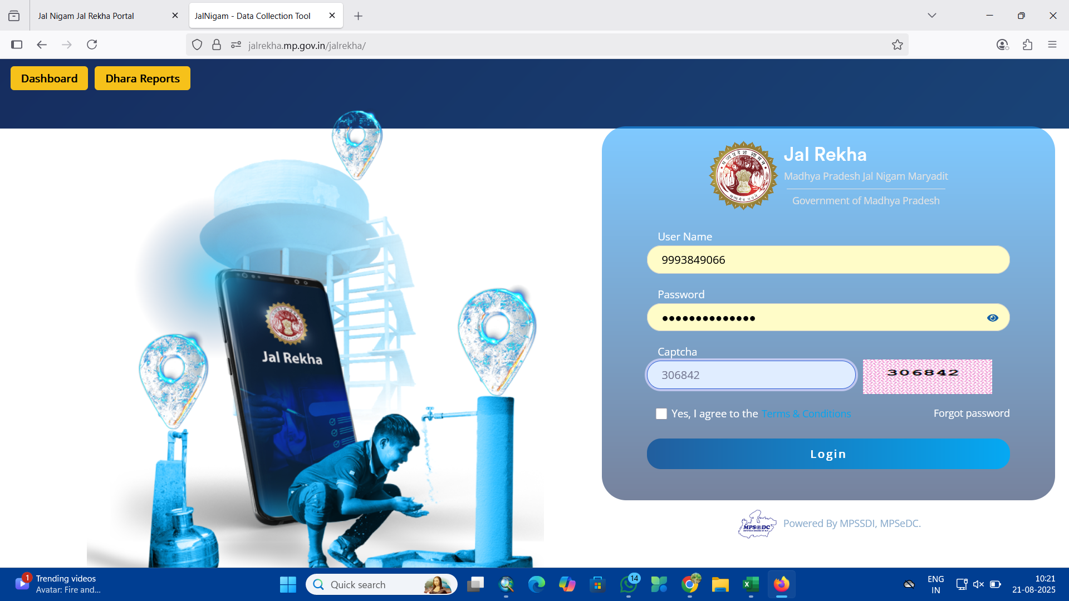
User Management

Slide 7
Dhara Module
The Jal Rekha project has been developed to tackle key challenges in monitoring and managing water supply schemes efficiently. By integrating digital tools, GIS-based mapping, and a structured workflow, the project enhances transparency, accountability, and operational efficiency. To achieve this, various methodologies have been adopted to streamline data collection, verification, and decision-making processes.
One of the primary challenges in water supply management is ensuring that contractor deliver the required quantity of water consistently. To address this, Jal Rekha incorporates the Dhara module, which empowers field engineers to capture and upload geotagged photographs of meter readings from critical water supply components, including: Intake Points Water Treatment Plants (WTPs) Overhead Tanks (OHTs) Village Supply Points By leveraging real-time data collection, Dhara ensures that water supply monitoring is more accurate and reliable. Payments to contractors are based on actual meter readings rather than manual reports, significantly reducing discrepancies and improving accountability.

Slide 8
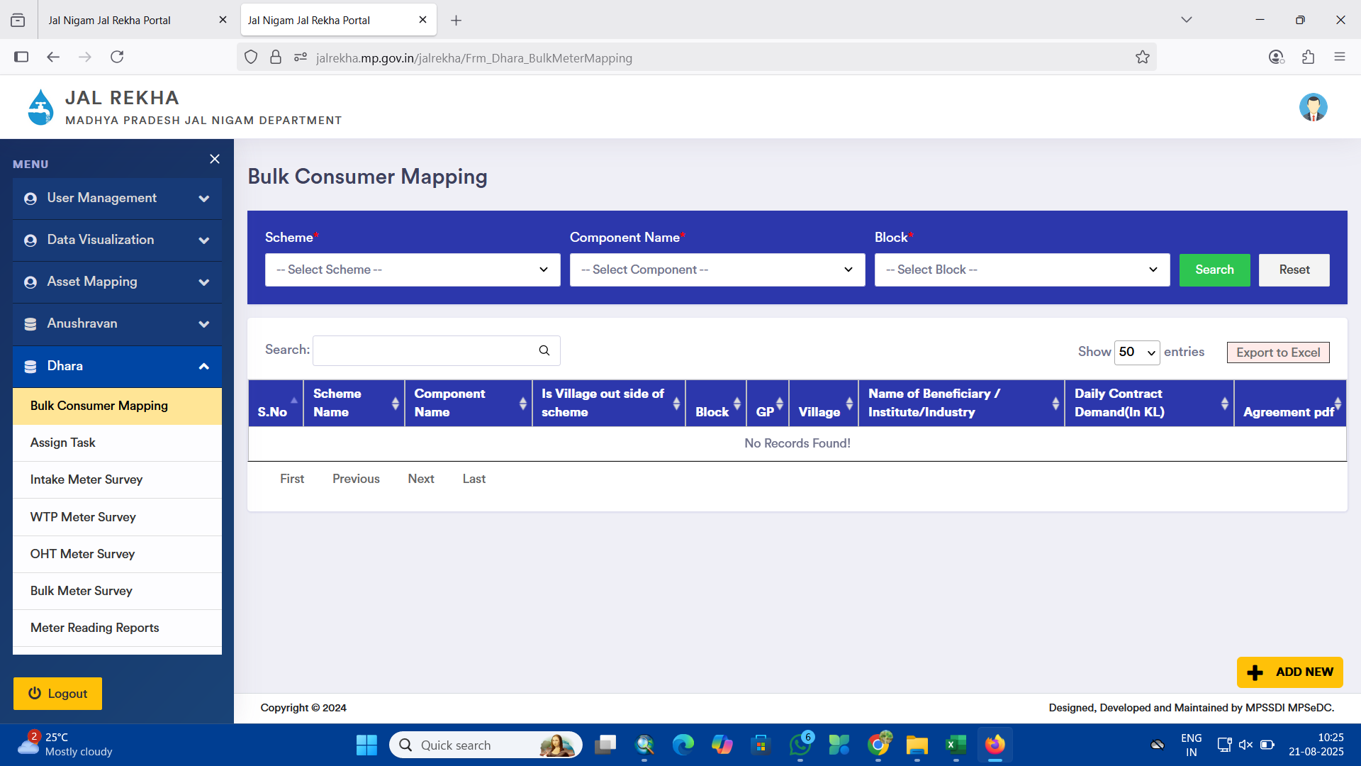

Slide 9
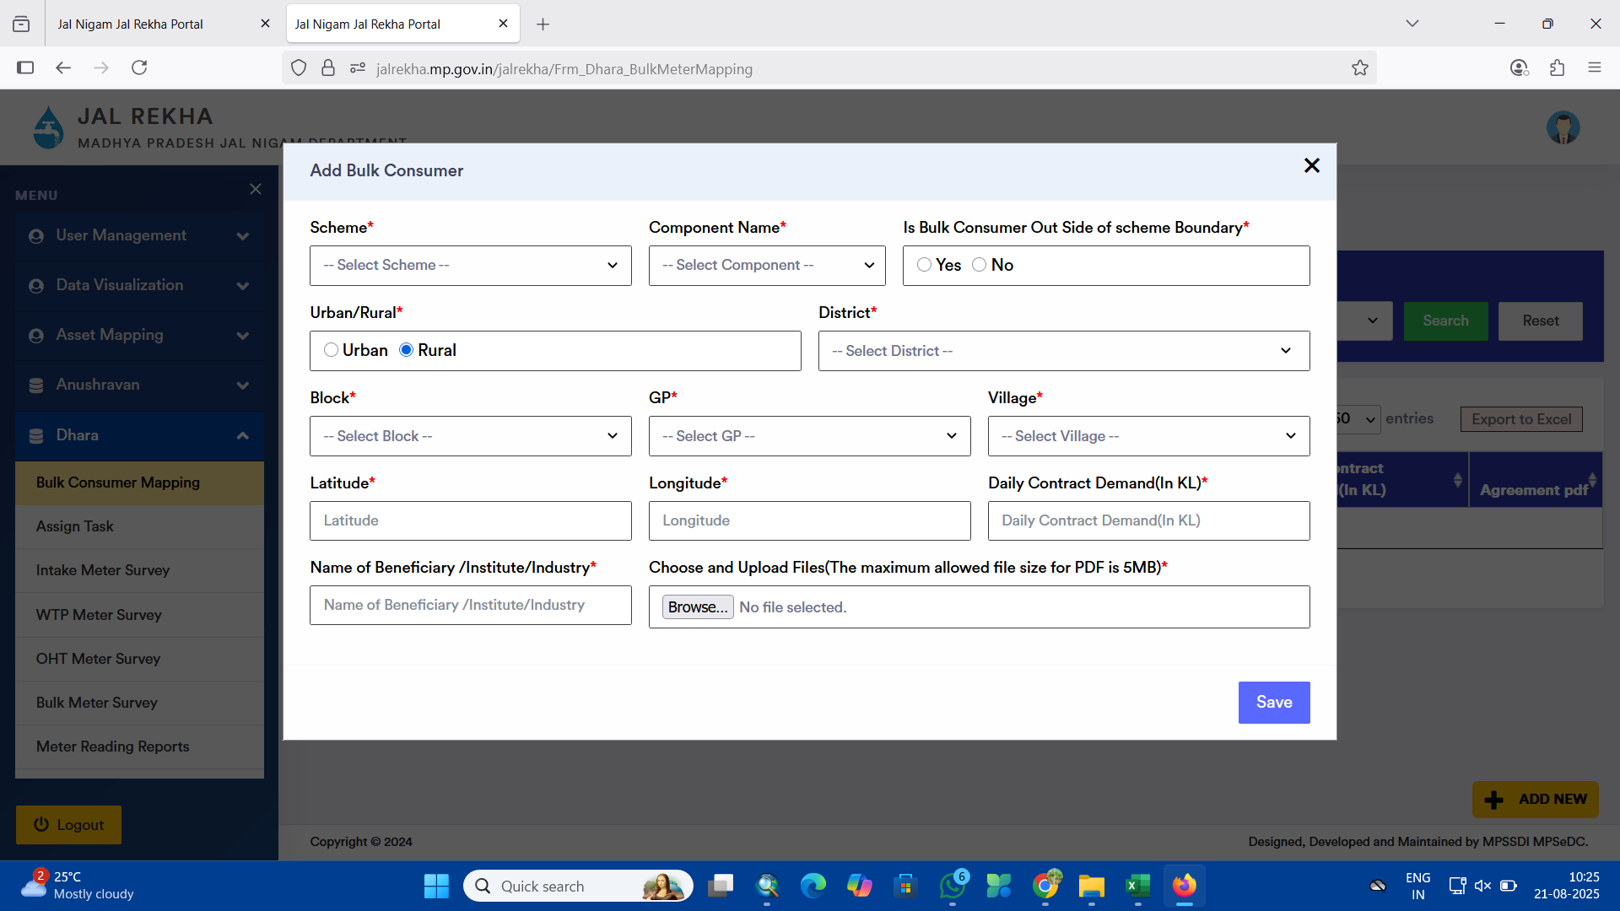

Slide 10
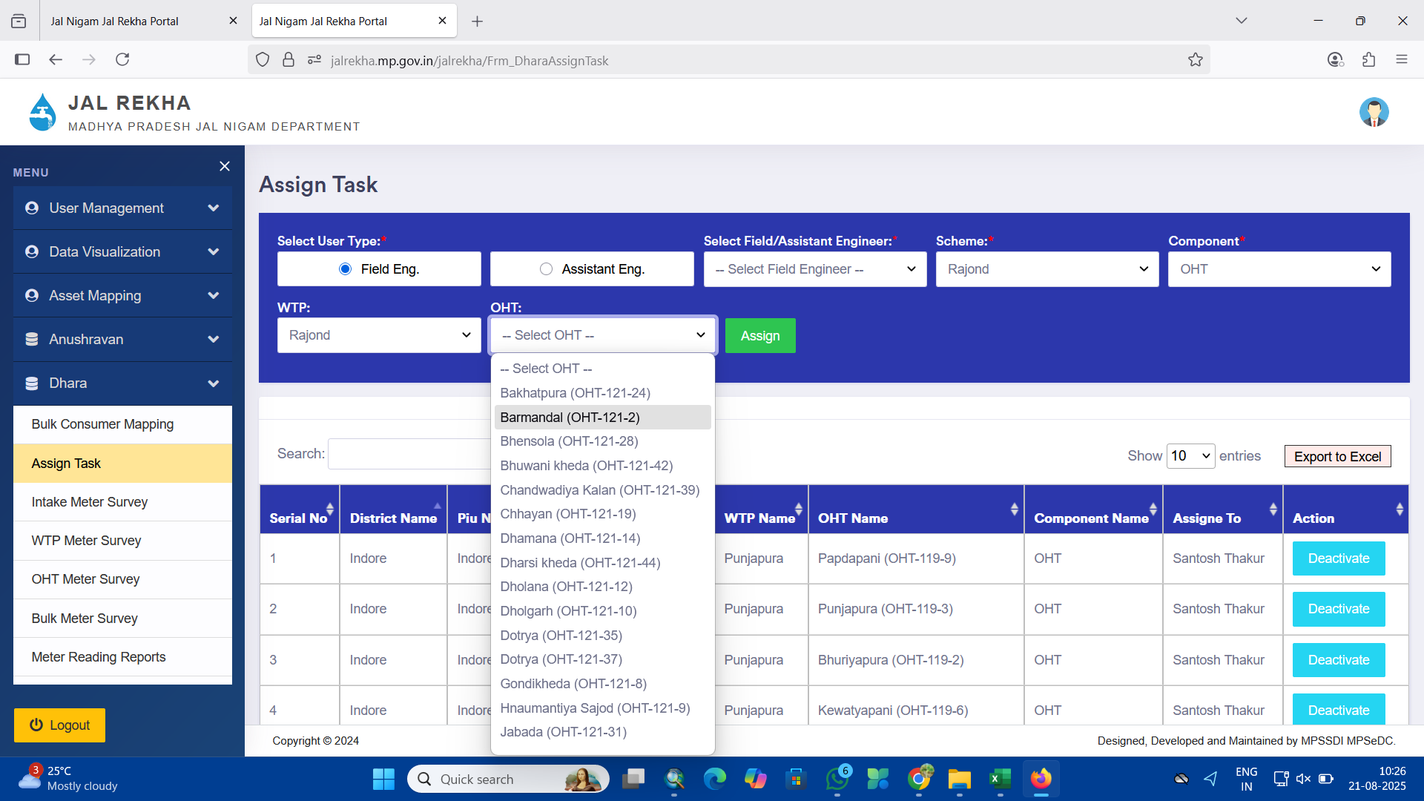

Slide 11
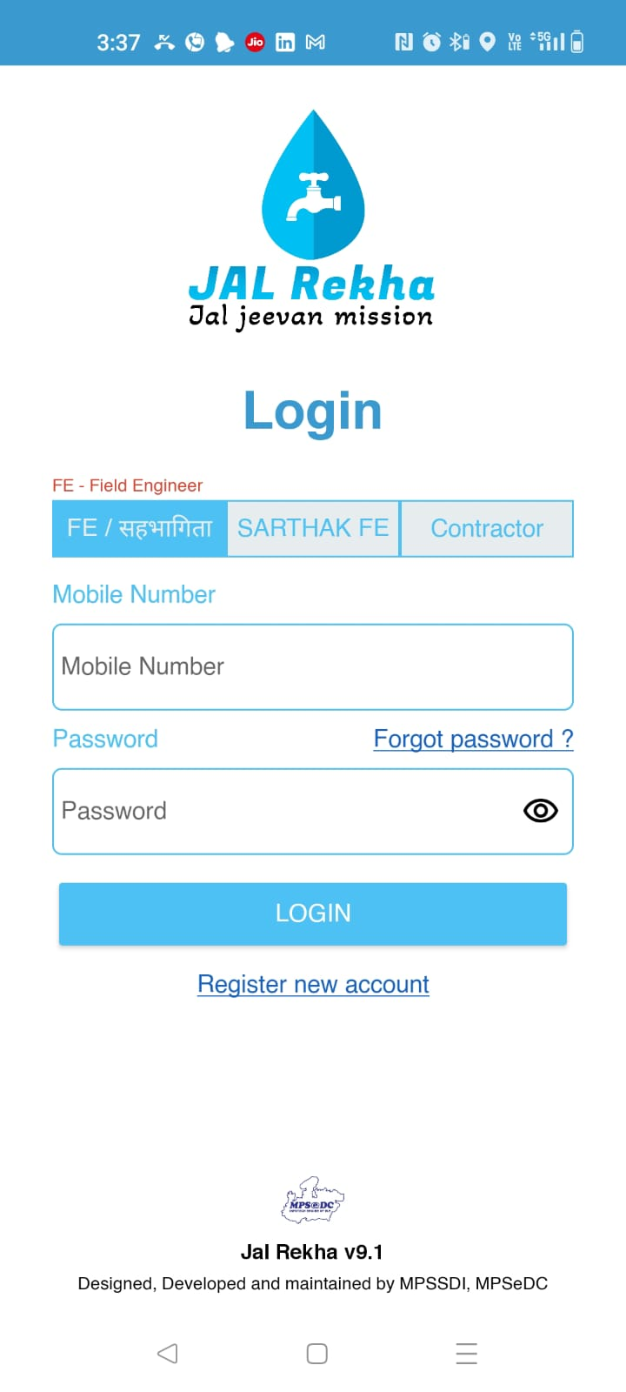

Slide 12
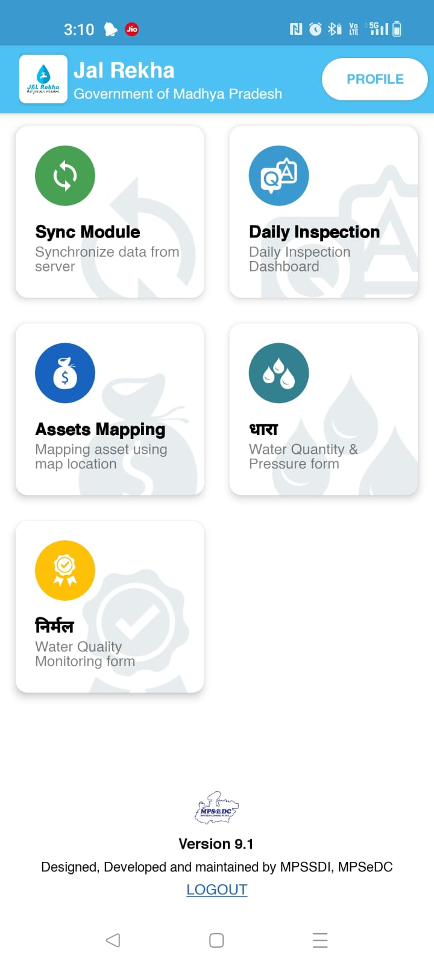
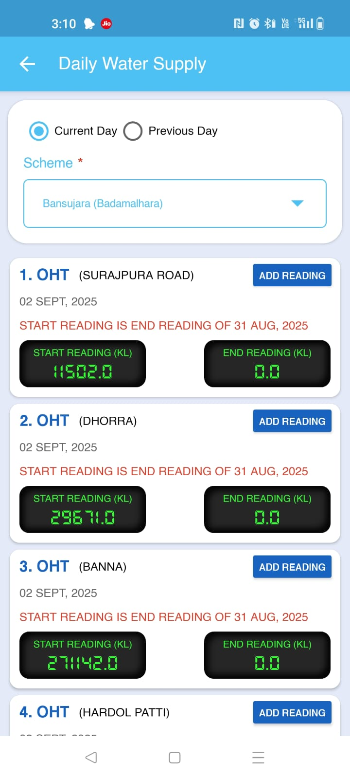
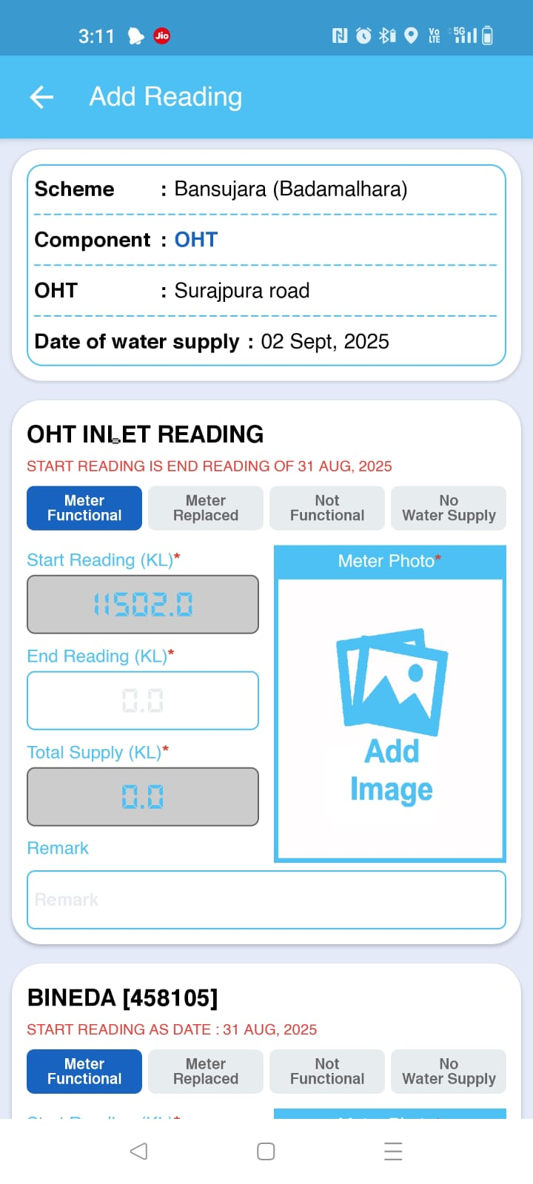
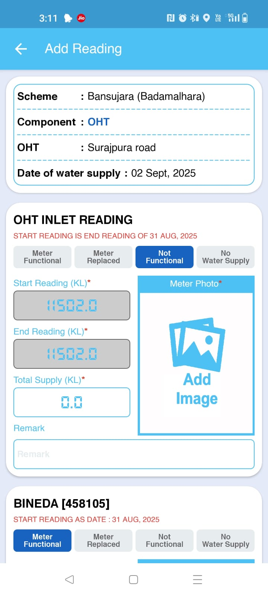
Dhara Module

Slide 13
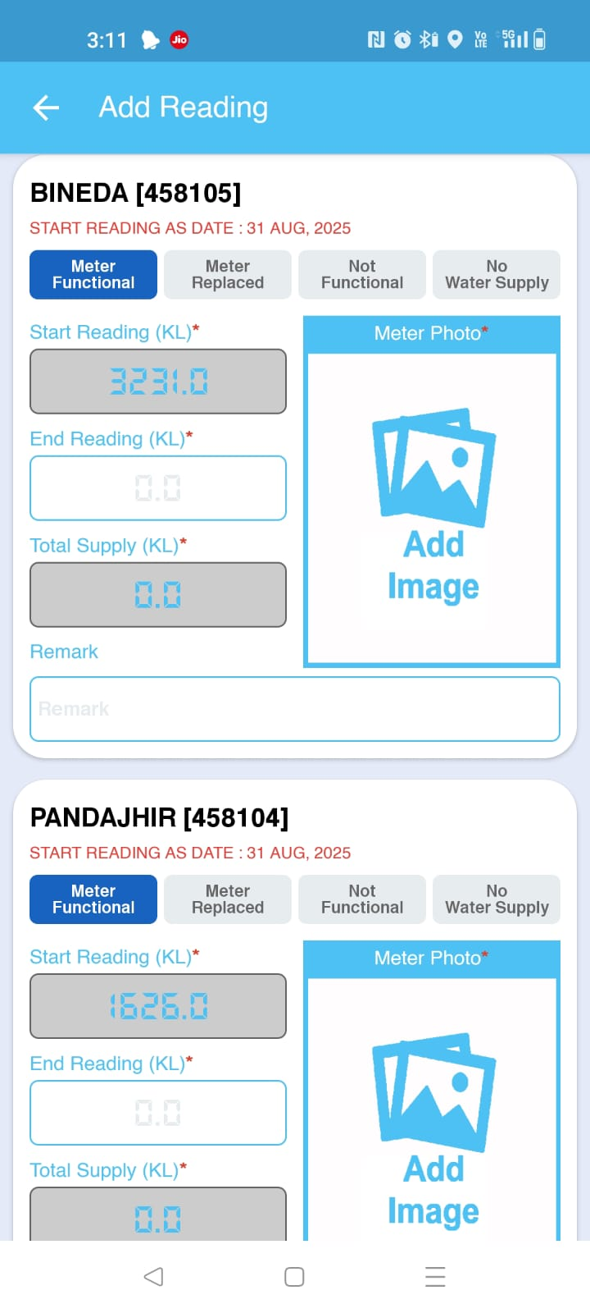
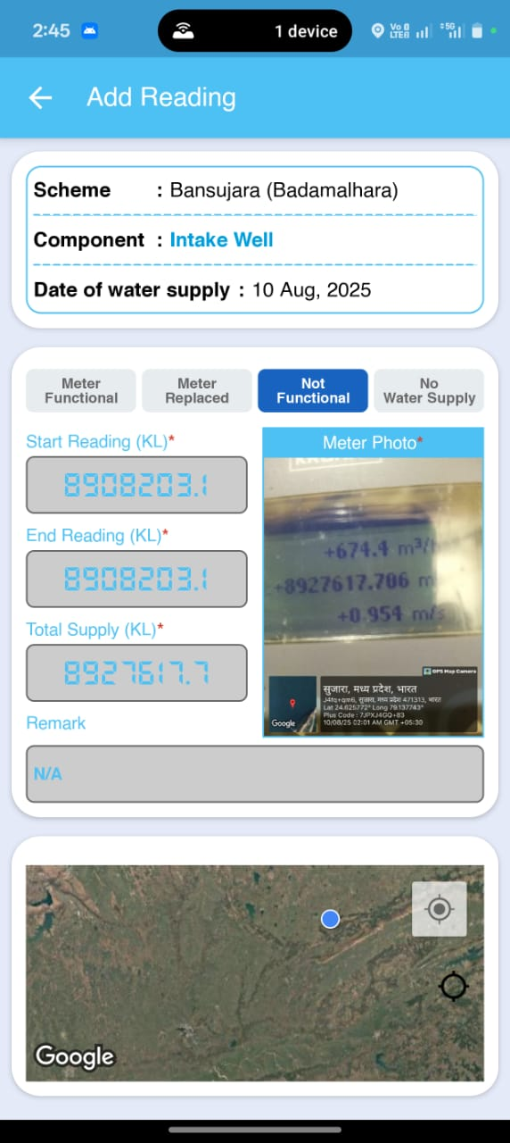

Slide 14
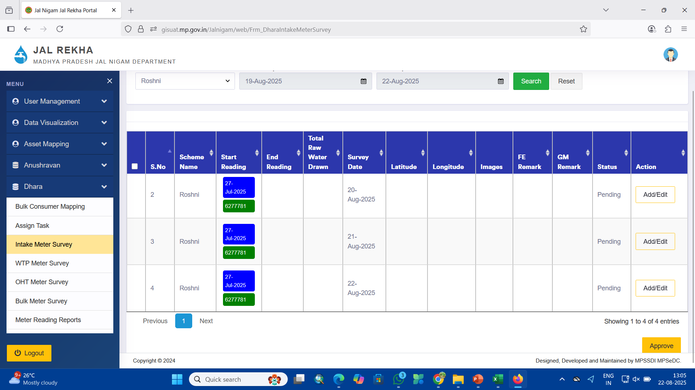

Slide 15
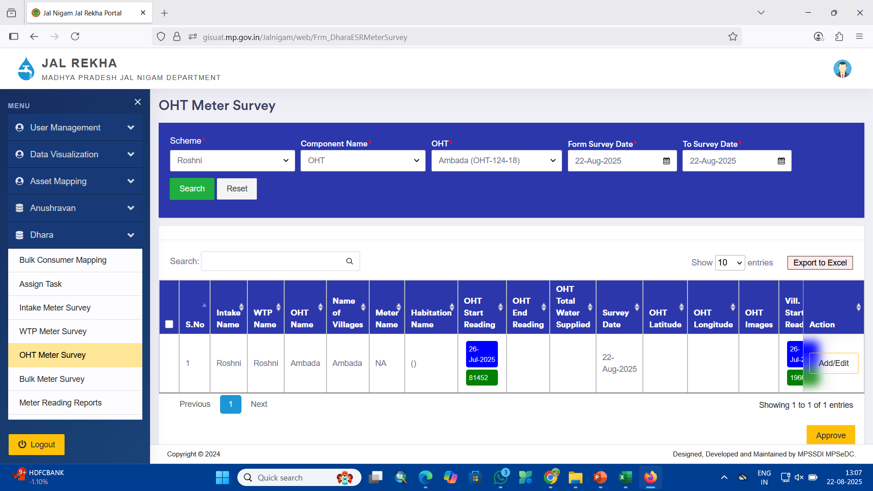

Slide 16
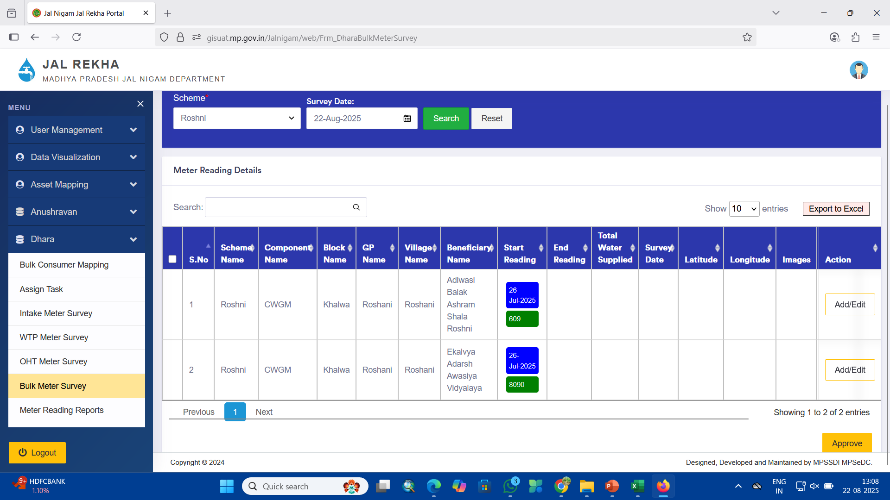
Pipe Line Master
Bulk Meter Survey

Slide 17
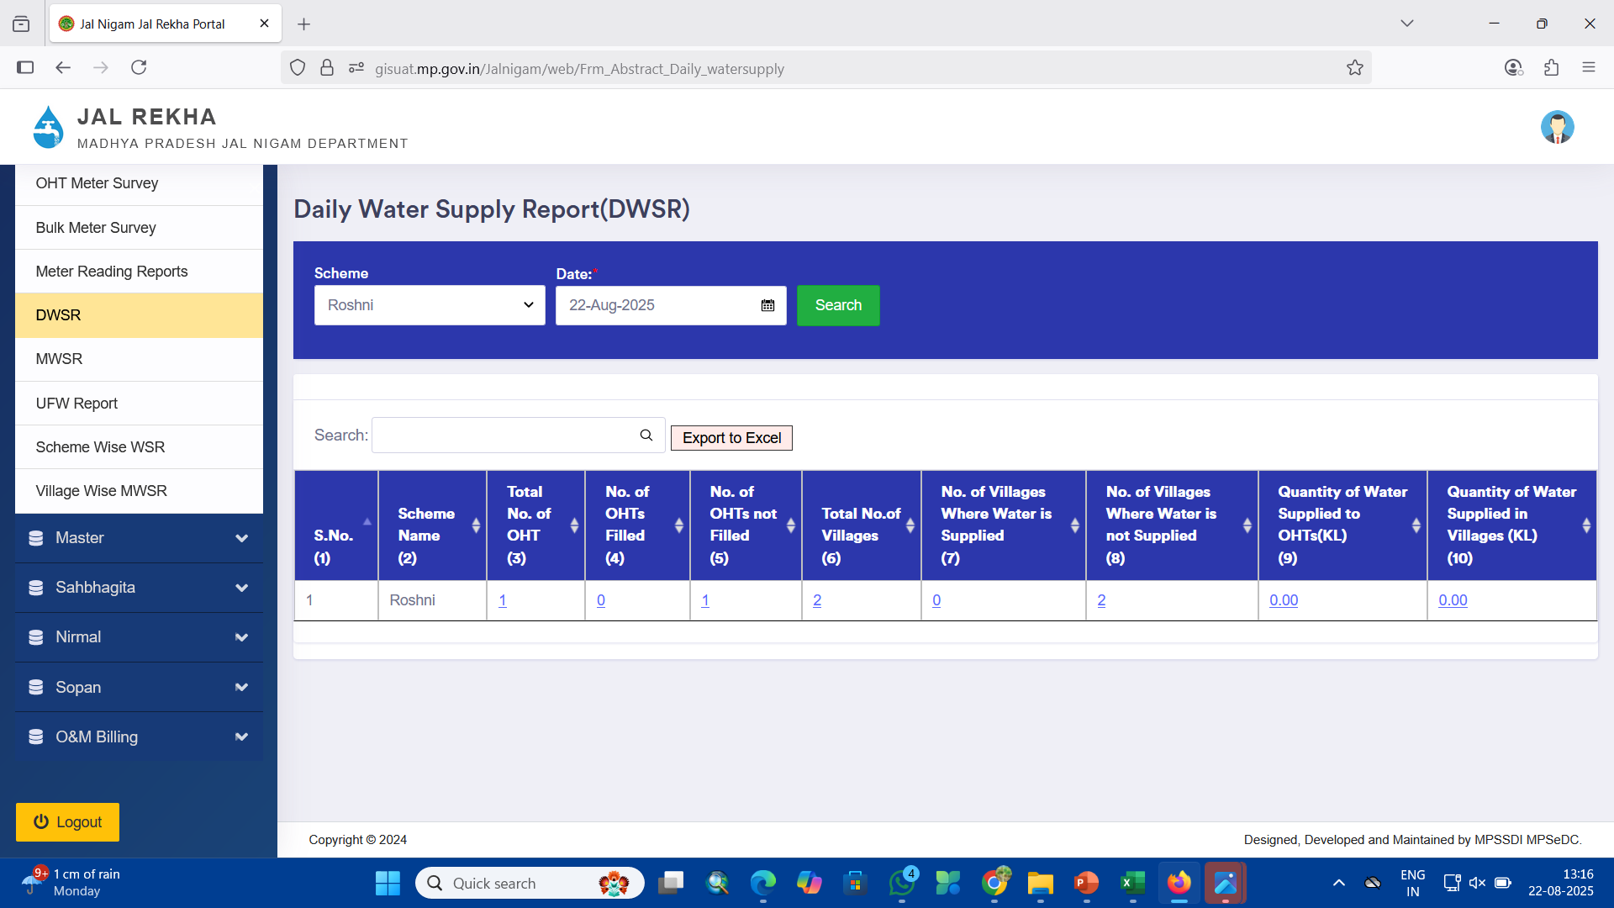

Slide 18
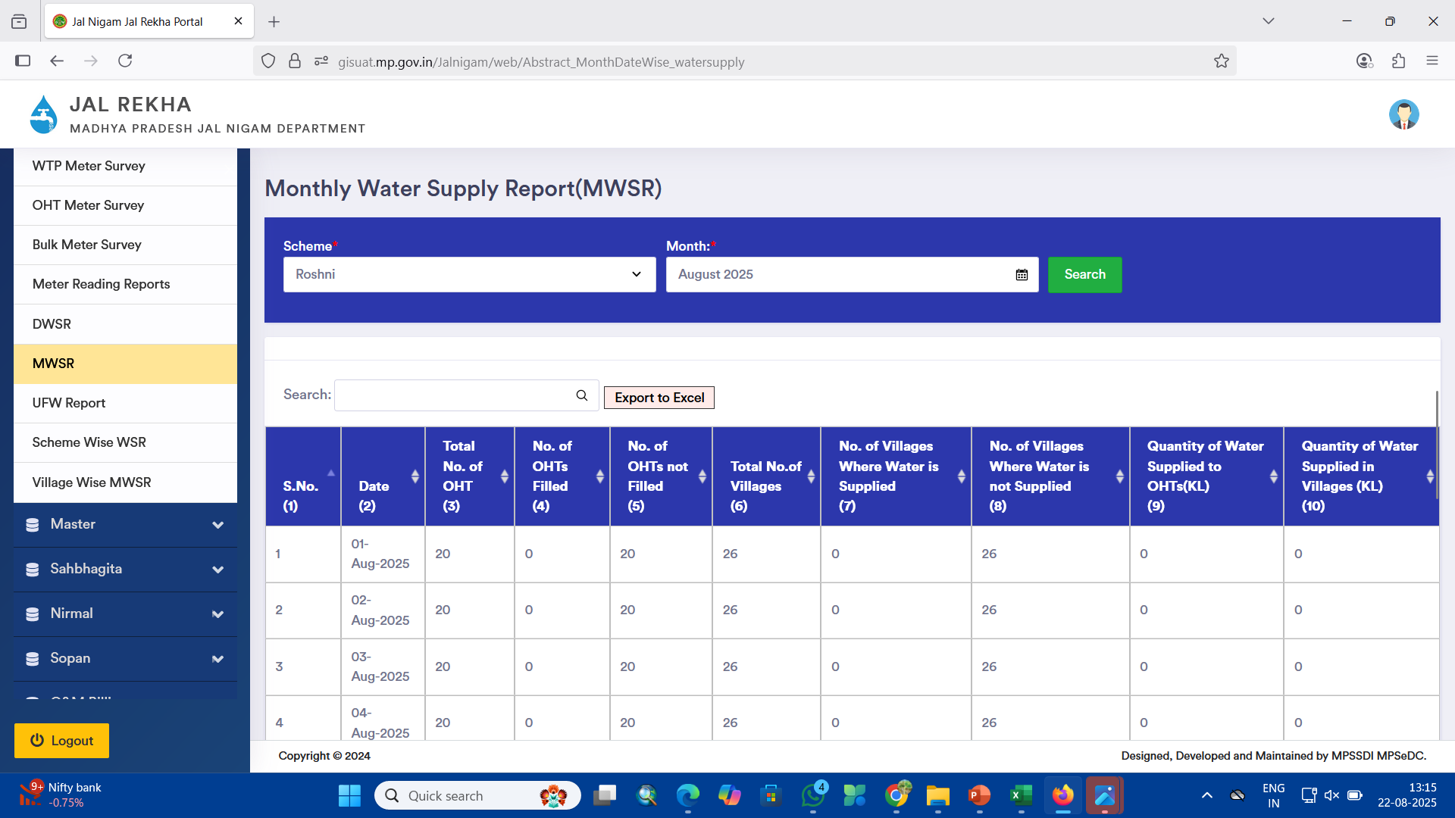

Slide 19
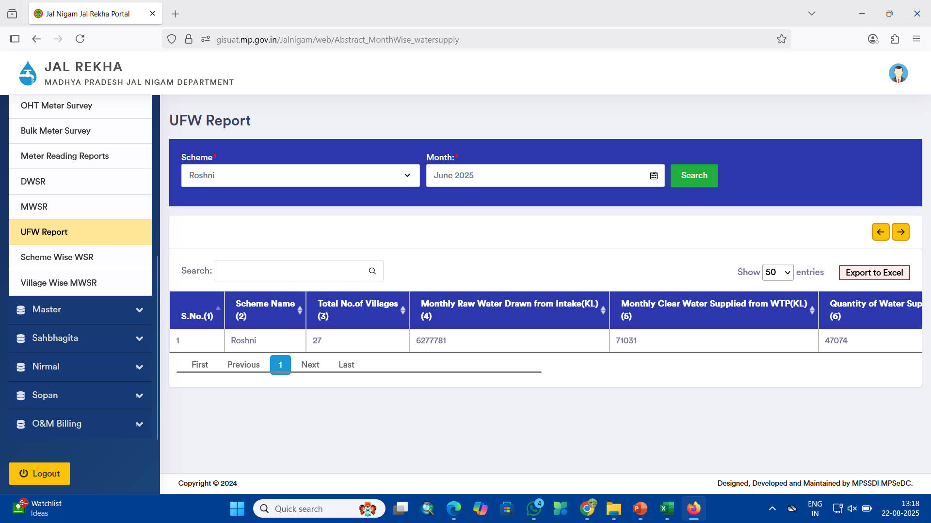

Slide 20
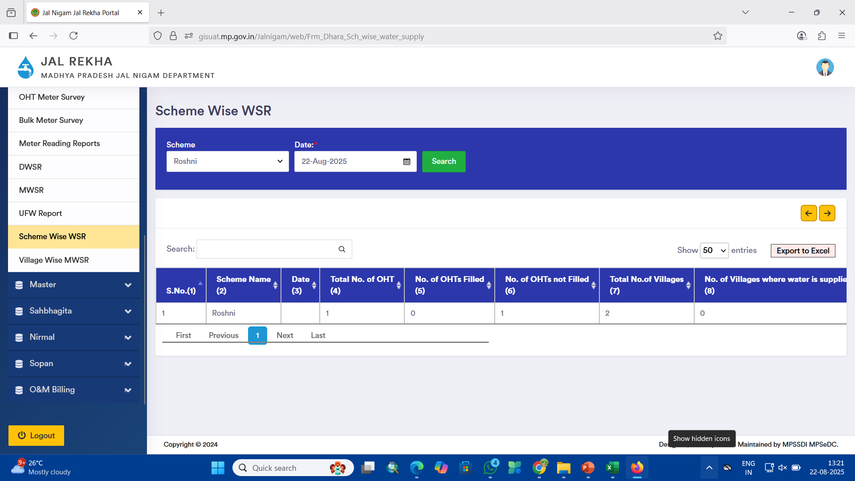

Slide 21
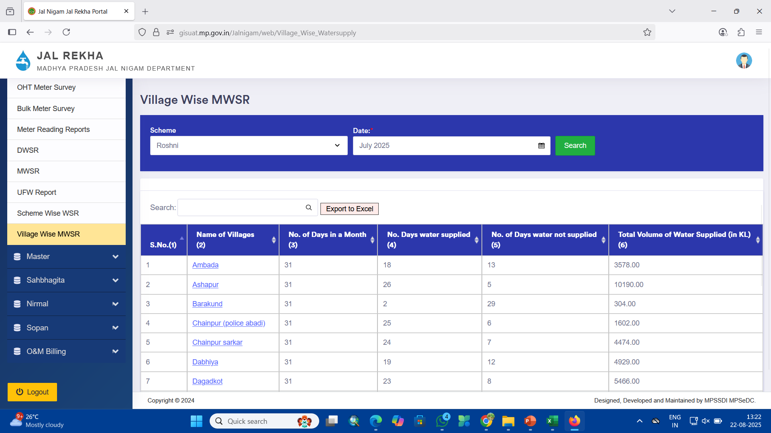

Slide 22
Nirmal Module
About Nirmal Module Maintaining high water quality standards is a critical challenge, especially in rural areas where water sources are vulnerable to contamination. The Nirmal module within Jal Rekha is dedicated to systematic water quality monitoring and management. Field engineers collect water samples from various components of the supply system and submit them to laboratories for testing. By digitizing the water quality monitoring process, Nirmal ensures adherence to safety regulations, supports proactive health measures, and enhances the reliability of rural water supply systems. This document serves as a step-by-step user manual to guide users in effectively operating the Nirmal mobile application.

Slide 23
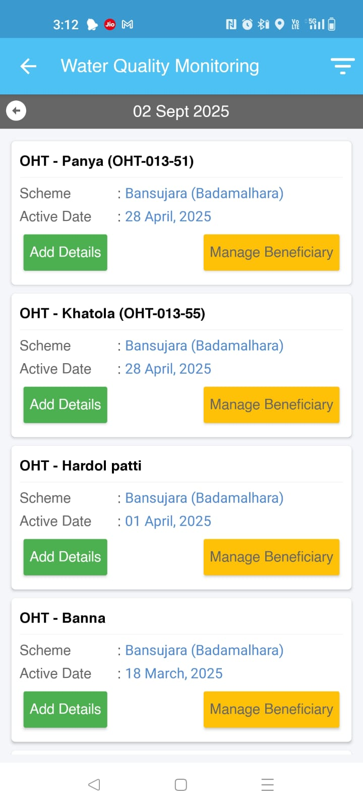
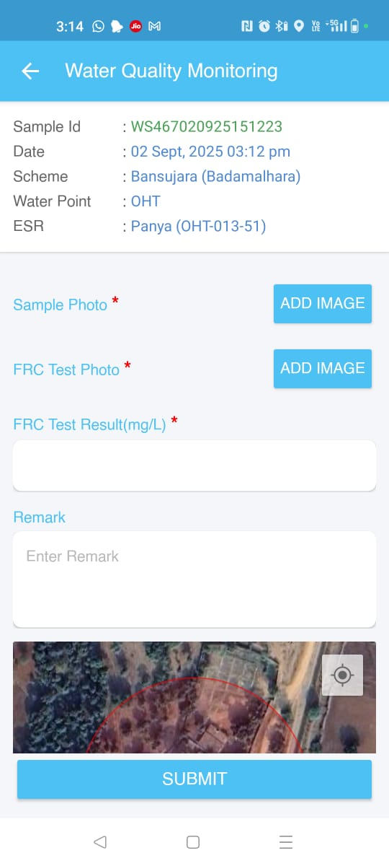
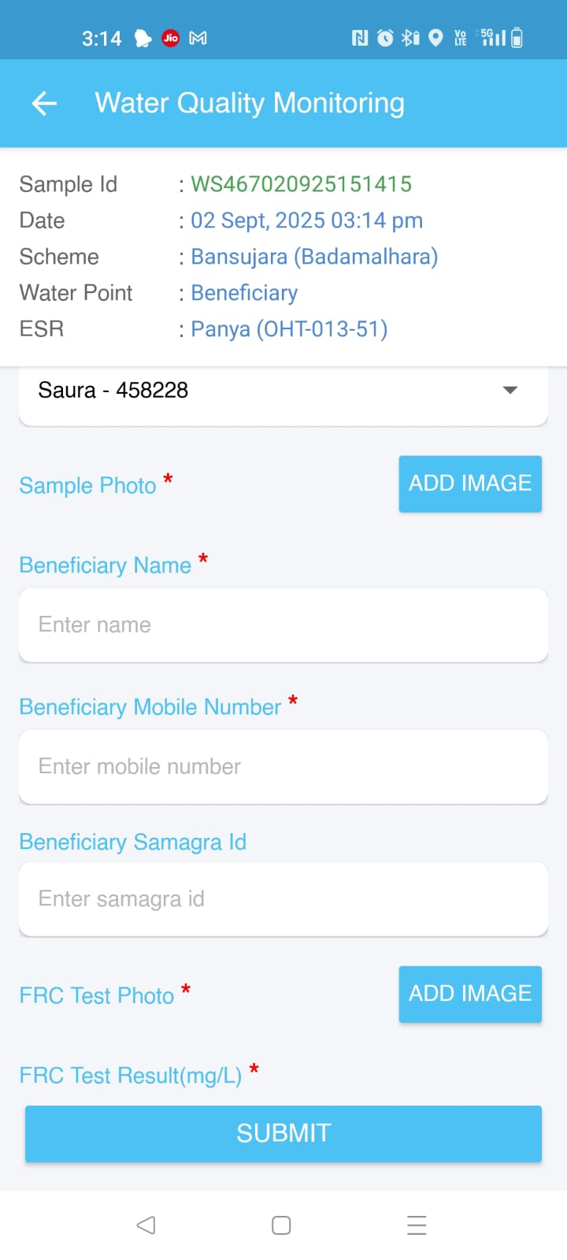
Nirmal Module

Slide 24
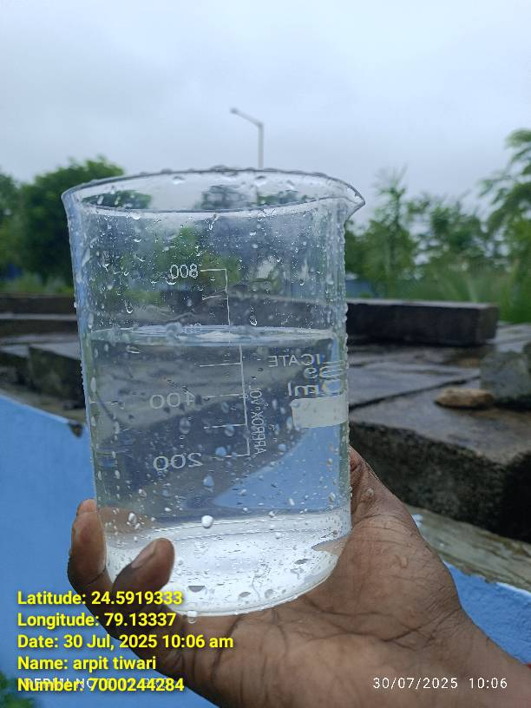
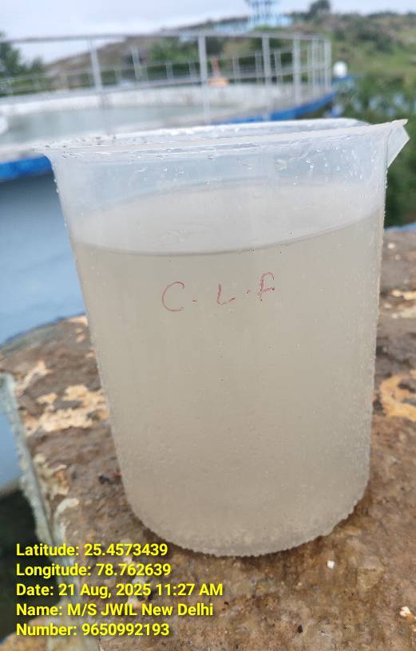
Clear water Sample at WTP
&
Raw Water Sample at Inlet WTP

Slide 25
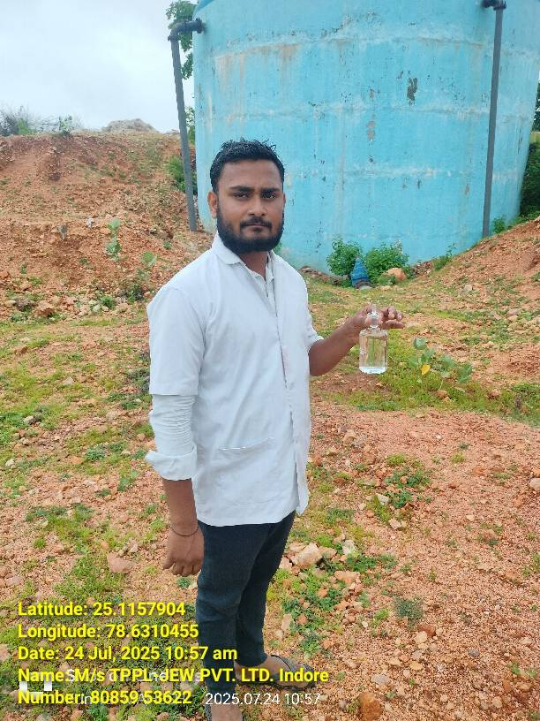
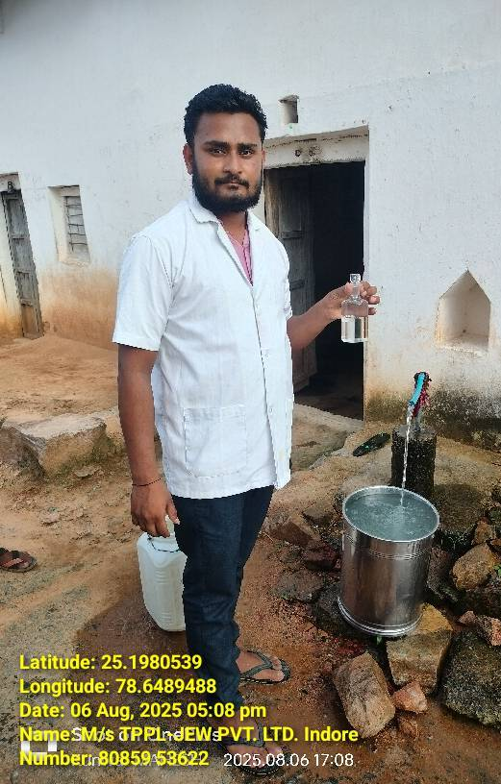
Sample at OHT
&
Beneficiary at Village

Slide 26
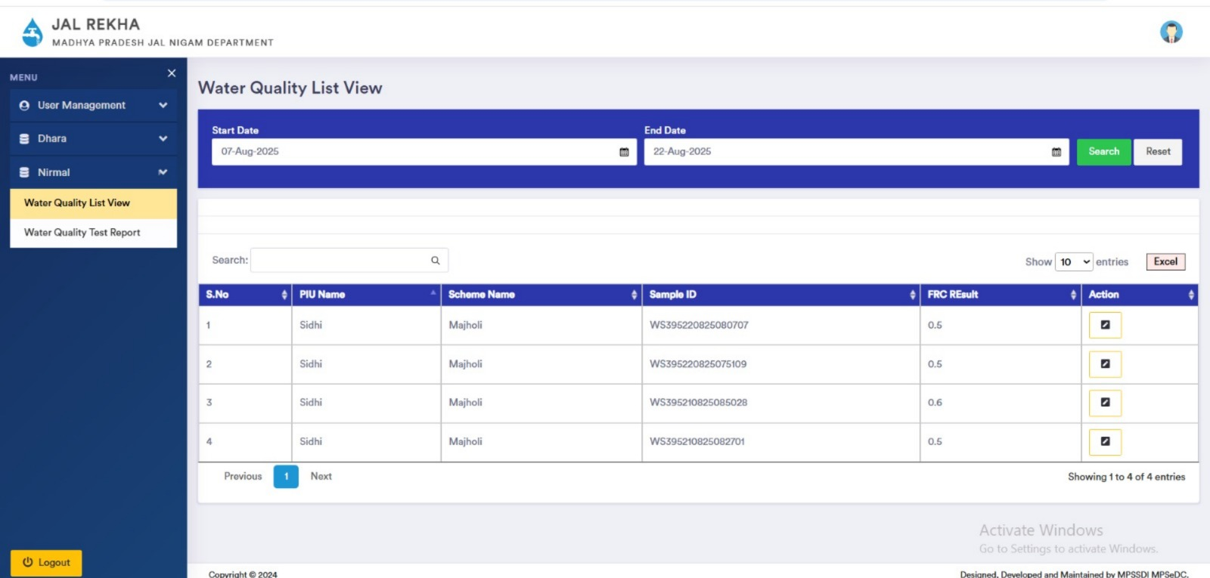

Slide 27
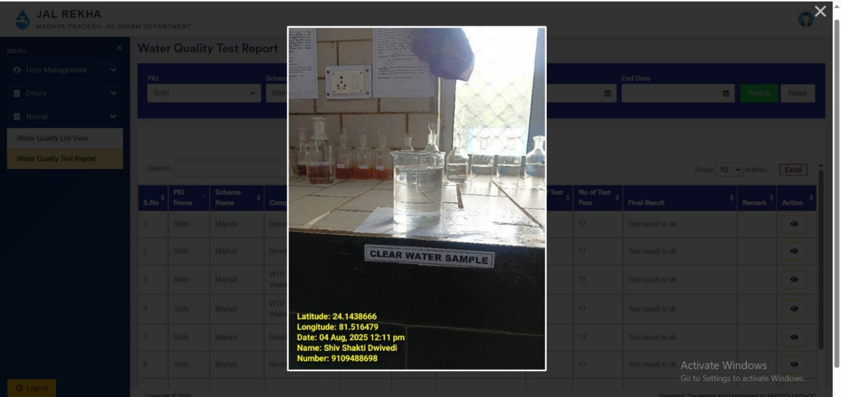

Slide 28
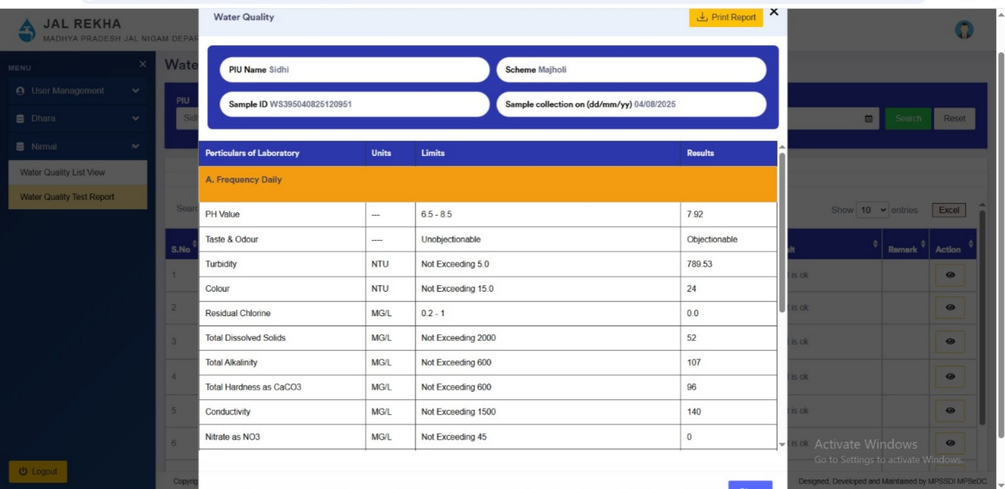

Slide 29
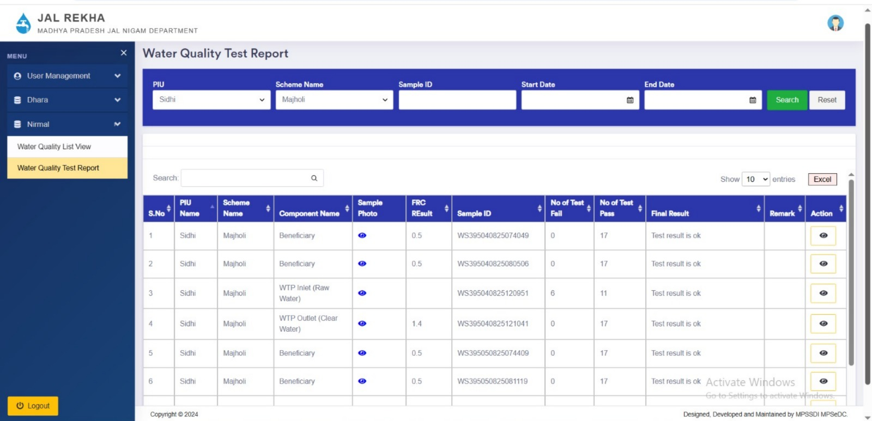

Slide 30
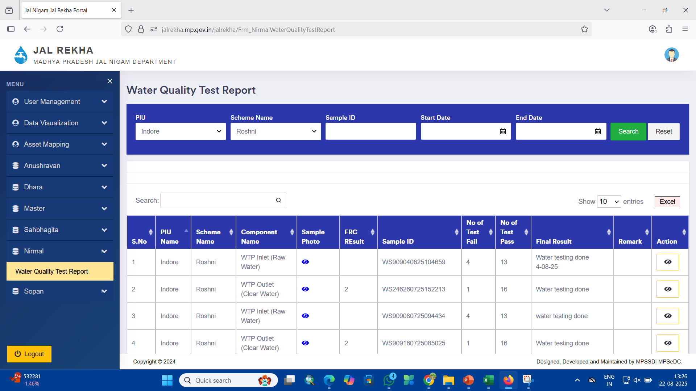

Slide 31
To view MPJN Water Supply Network on Geoportal
https://jalrekha.mp.gov.in/MPPHE_New/

Slide 32
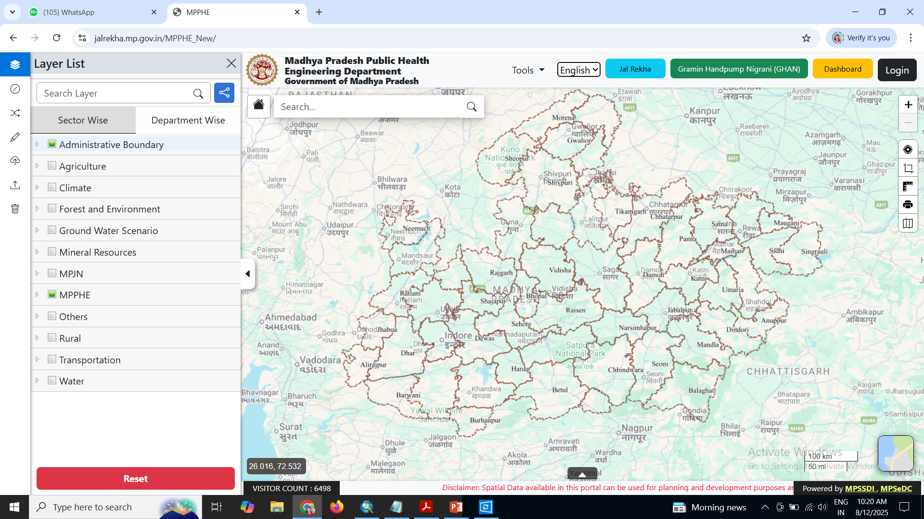
Click on this
Main Geoportal

Slide 33
1. Click on Administrative Boundary and click on check box of Village.
2. Click on MPJN Tab – There are 2 Tab of Design and Drawing & Field Survey Data
3. In both tab layers of water supply components there, click on check box to view. Zoom on particular area to view.

Slide 34
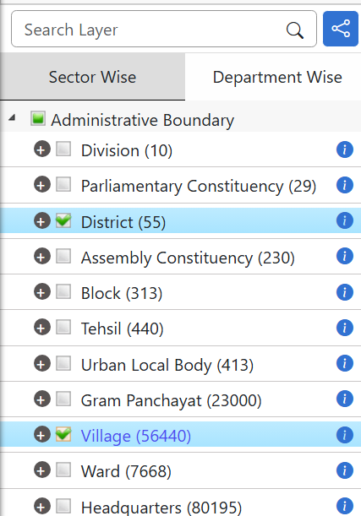
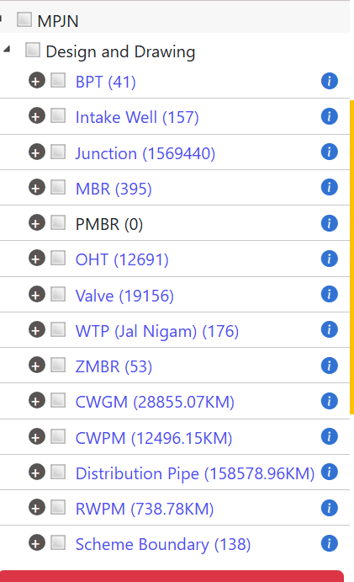
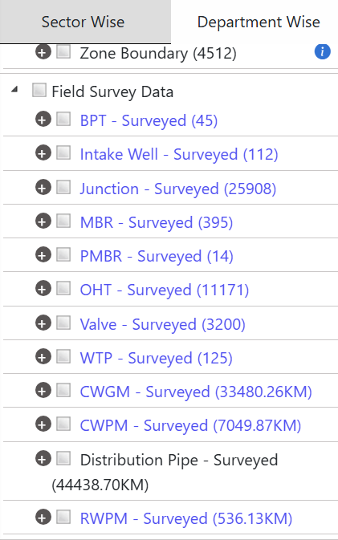

Slide 35
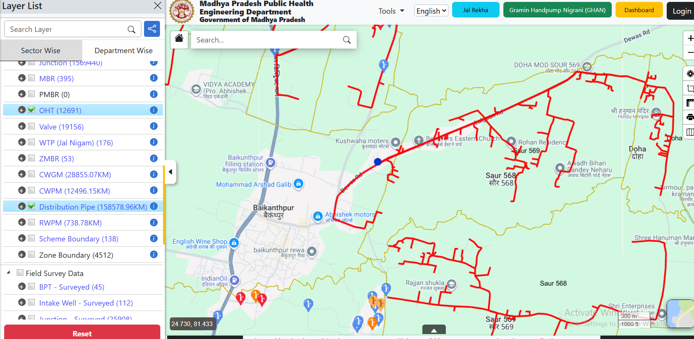
Red line showing Proposed distribution

Slide 36
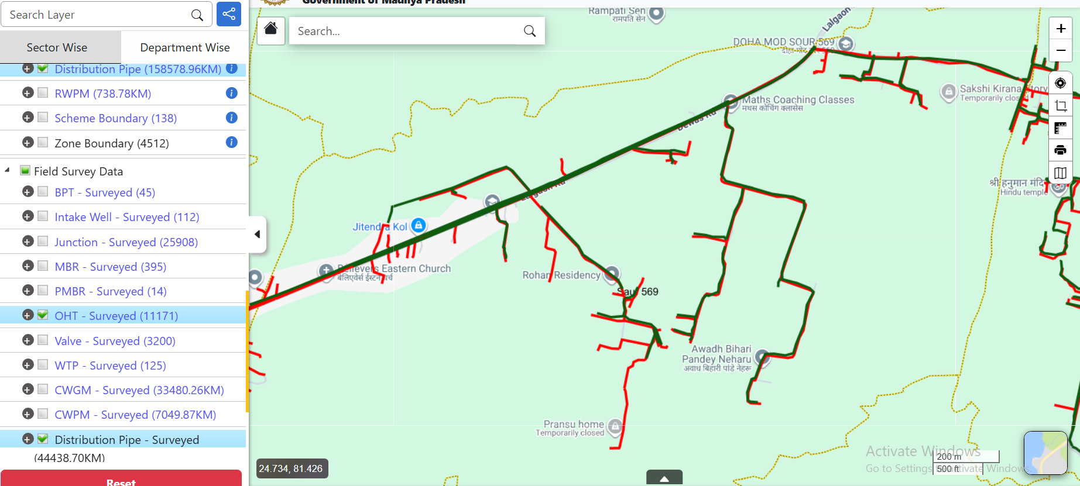
Click on this to layers
on Satellite image
Green line showing Laid Surveyed line (asset mapping using Jal Rekha App)
You can overlay both Proposed & Surveyed line. Click on-off on check box.

Slide 37
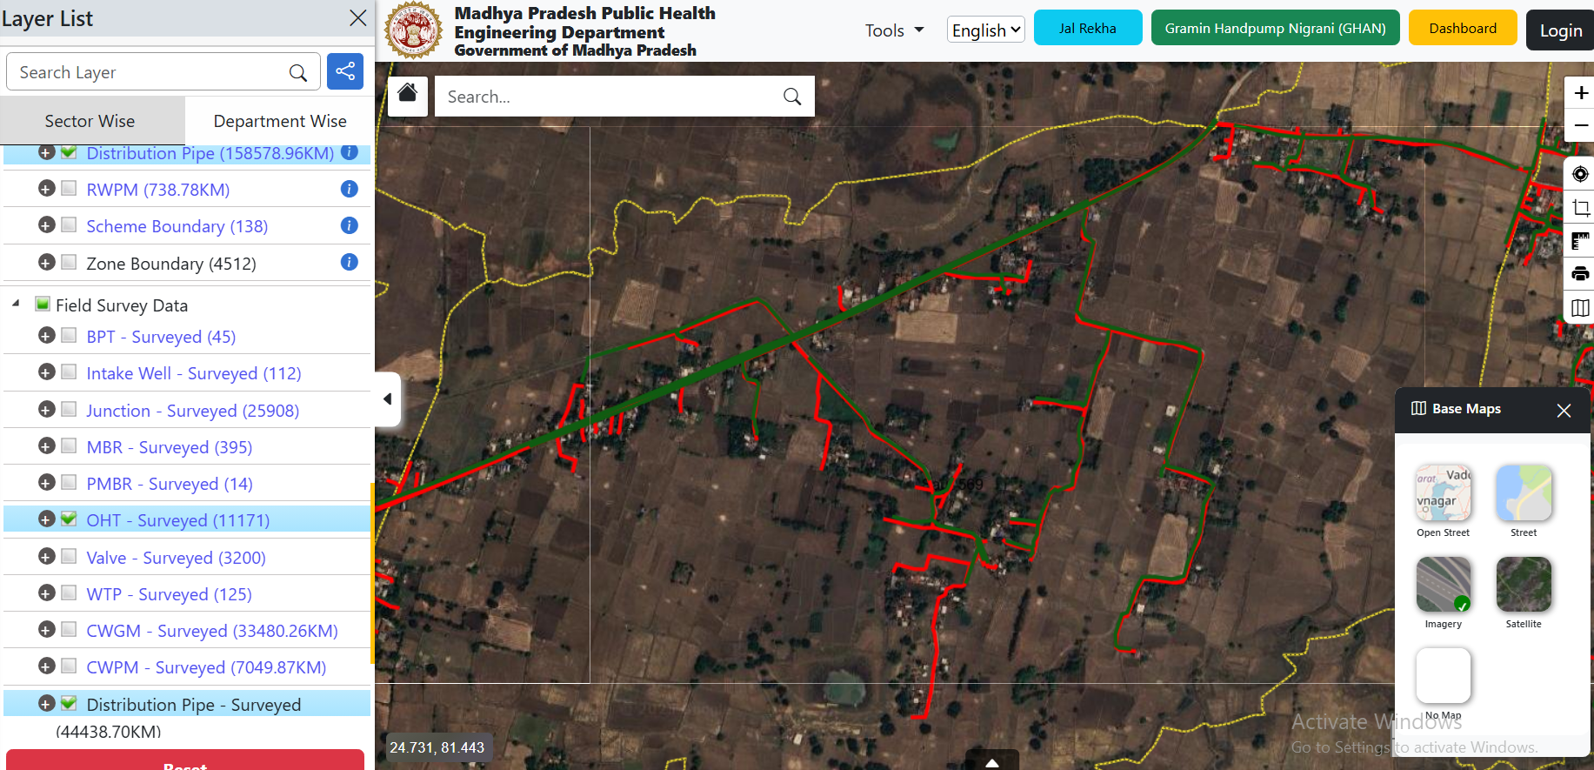

Slide 38
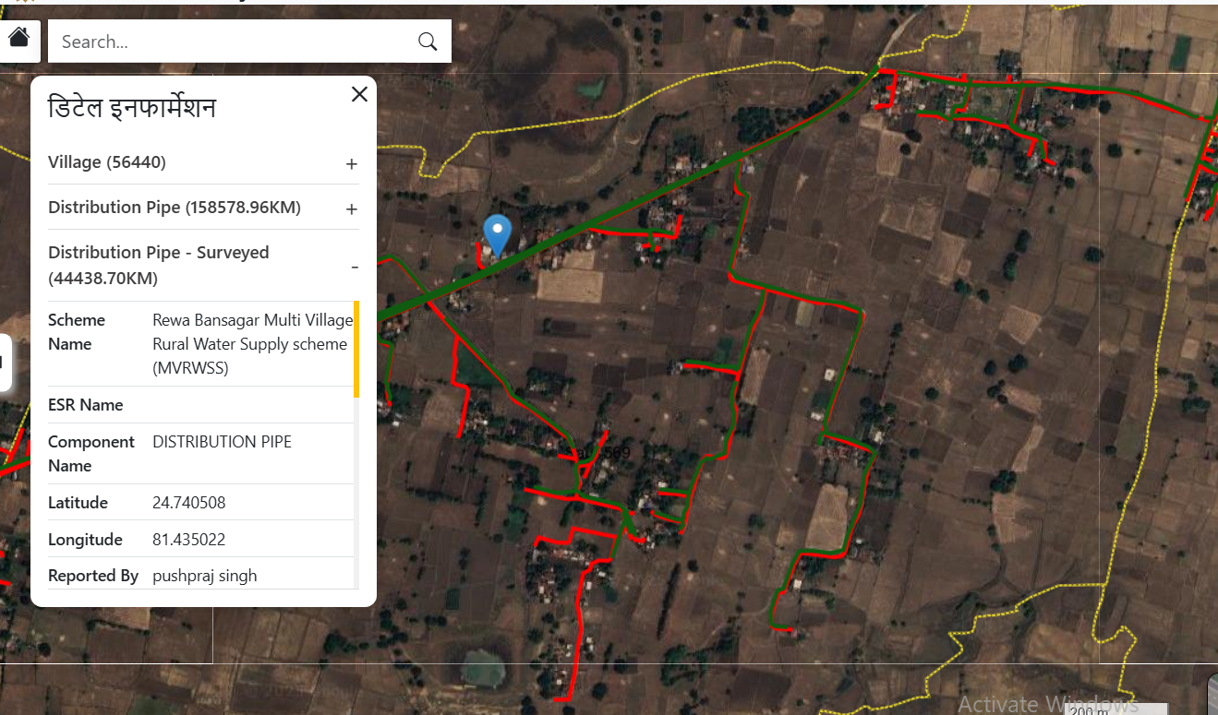
Click on line or point to see attribute detail

Slide 39
Thank you

